Slide 1
R programming for beginners
Introduction
Jason Gullifer

Slide 3
Slack group
Slack group to interact with us or the TA's during lectures
  http://rworkshop-gaspcrblm.slack.com/
TAs
  Naomi, Sivaniya, Mehrgol, and David
Course website
  http://jasonwgullifer.com/rworkshop/
  Download zip
  Go into docs/ and put "datasets" and "practicals" somewhere you will find them.

Slide 4
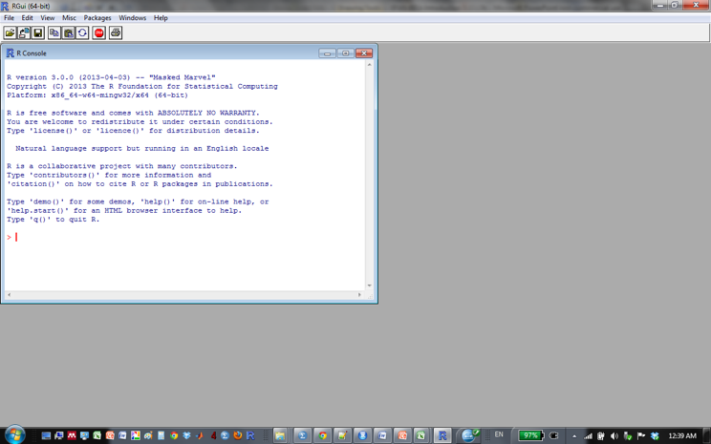
What is R?
R is a software environment for statistical computing and graphics
  It's also a programming language.
  Runs on multiple platforms (Linux Mac, Windows)
A command-line too that you use to import, process, and analyze data
  But there are several front-ends which make it pretty
Downloadable from:
  http://www.r-project.org/
  http://cran.r-project.org/mirrors.htm

Slide 5
Frontends for R
Frontends available
  R-studio
  Detailed interface
    See variables you’ve defined, plots, etc. in one application
  Good for managing projects
  https://www.rstudio.com

Slide 6
Frontends for R
  Project jupyter (http://jupyter.org)
  Reproducible research; incorporate formatted text and R output in one a “notebook”

Slide 7
What can you do with it?
Fancy calculator
Process data
  Calculate values per participant / group / etc.
  Clean your data (identify and remove outliers)
  Prepare data for analysis (get it into the appropriate format/orientation)
trial subject RT
1 1 250
2 1 350
3 1 257
4 1 600
1 2 302
2 2 310
3 2 305
4 2 312
subject mean_RT sd_RT
1 364.25 163.64
2 307.25 4.57

Slide 8
What can you do with it?
Plot data
  ggplot
Analyze data
  T-test
  Regression
  ANOVA
  Mixed-effects regression
  PCA/ICA
  Mediation analysis

Slide 9
Common situation:
You spend hours preparing data by-hand for an adivsor meeting
You calculated your means for each subject in each condition
SDs for each subject in each condition
You even found that error where you calculated the mean from the wrong column
Your spreadsheet is awesome
Advisor: “I think we should exclude xyz trial type” -or- “for our next meeting, we need to see this condition broken down”

Slide 10

Solutions?
By-hand calculations
  Spend several more hours redoing the calculations
With R
  Add line to the existing script
  Hit “Run”
vs

Slide 11
Why use R for processing data (vs. Excel)
Mistakes are generally applied equally
  E.g., Offset values for everyone
  Error messages
  Excel: prone to tiny copy paste mistakes
Replicability
  Script / text file that you make to accomplish the procedure
  Ask yourself
    Will I be doing this again?
    Will writing a script now save me time in the future?
    Is this task really the same thing done over and over again?

Slide 12
Why use R for processing data (vs. Excel)
Data formatting
  R encourages good formatting of data
  All participants gathered together in one sheet
  Column coding participant, measures / variables in separate columns
  Excel encourages visually pleasing formatting
    Separate sheets per participant, multiple tasks on one sheet
    Not great for actually analyzing data; lots of time spent reformatting

Slide 13
Why use R for processing data (vs. Excel)
Speed
  Slowdown with large excel spreadsheet with many formulas
  Parallelization in R
Modularity
  Parts of the code can be swapped out and improved

Slide 14
Why use R for analysis (vs. SPSS)
It’s free
  McGill provides SPSS but..
  License won’t expire during the last chapter of your thesis
  Your next university may not offer it…
It’s open source
  Public contribution
  Public verification
Extensible
  An array of community developed packages
Cross platform (Linux, Mac, Win support)

Slide 15

It could help you get a job…

Slide 16
Popularity of statistical packages
Popularity in industry
Popularity in academia
http://r4stats.com/articles/popularity/

Slide 17
Thinking like a computer
Programming can be incredibly frustrating
  Also incredibly rewarding
Computers are very powerful and fast
  But also incredibly stupid
Programming is mostly figuring out what stupid thing the computer is doing that any human would obviously never do

