Slide 1
R programming for beginners
Plotting with ggplot2
Jason Gullifer

Slide 2
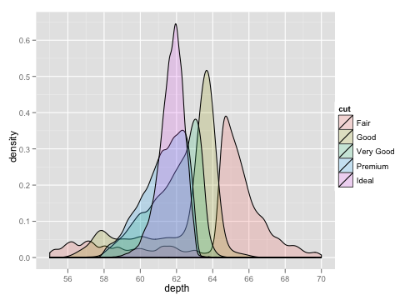
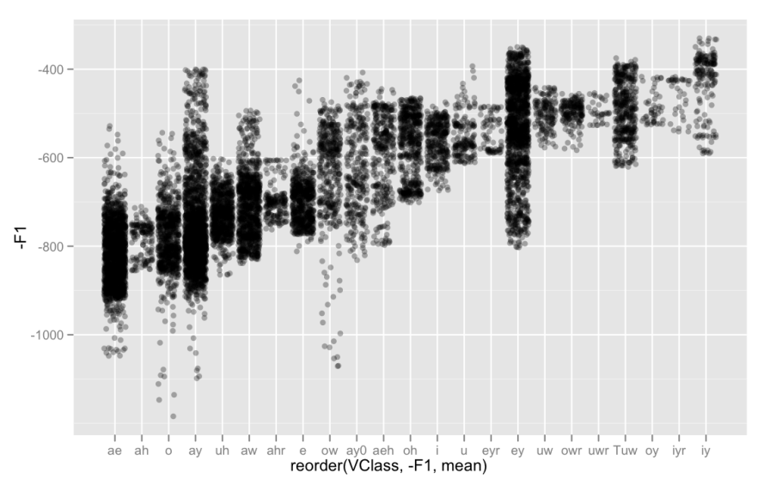
ggplot2
Implementation of the grammar of graphics in R
By Hadley Wickham – ggplot2.org
Layer based plotting
Can continually add layers to improve your plot
Allows interactive plotting

Slide 3
Getting help
ggplot2 book – online for free
http://ggplot2.org/book/
online documentation
http://docs.ggplot2.org/0.9.3.1/index.html
Useful to look up commands and arguments taken
Several online tutorials
http://tutorials.iq.harvard.edu/R/Rgraphics/Rgraphics.html

Slide 4
General structure of a ggplot
Plots have data!
Could work with "raw data"
Could work with aggregated data
Have ggplot aggregate your data
Aggregate data yourself with dplyr

Slide 5
General structure of a ggplot
Plots have geometric objects
geoms
E.g.,
bars
points
lines
text
many more!
Images from: http://docs.ggplot2.org/

Slide 6
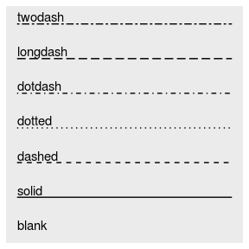
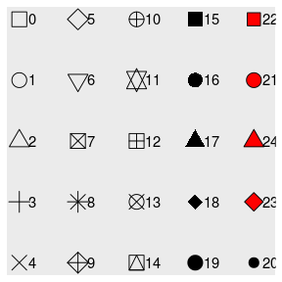
General structure of a ggplot
Plots have aesthetics
E.g.,
Size
Position
Colors
Groups
Line type
and more!
Images from: http://docs.ggplot2.org/

Slide 7
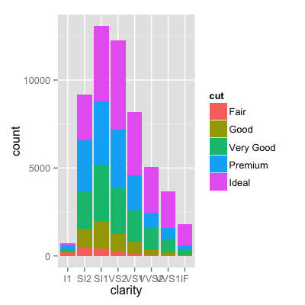
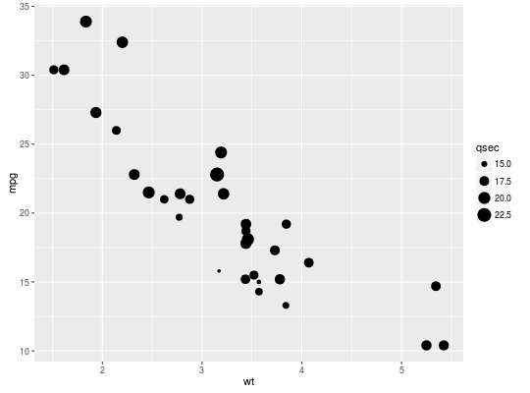
General structure of a ggplot
Plots have aesthetics
Aesthetics can often be made contingent on aspects of the data
Or set by hand…
Images from: http://docs.ggplot2.org/

Slide 8
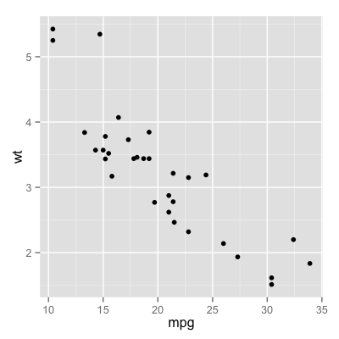
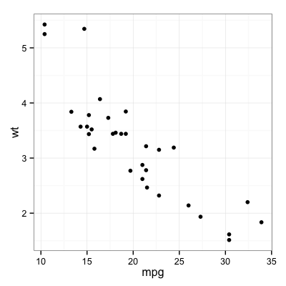
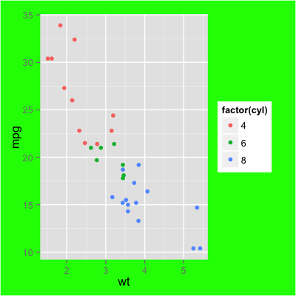
General structure of a ggplot
Plots also have themes
Images from: http://docs.ggplot2.org/

Slide 9
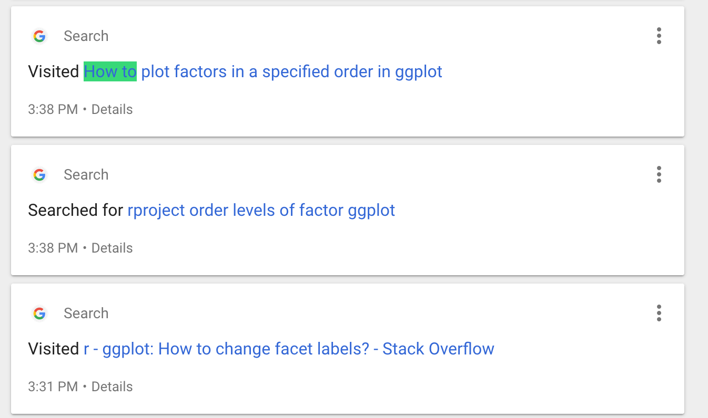
When it comes to ggplot2
Google is your friend!

Slide 10
Dataset
new_vices
Merged dataset: movie information into disney vices

Slide 11
General structure of a ggplot
ggplot(vices, aes(x = Year, y = Length_Minutes))
ggplot call
variables to plot on the axes, variables to color or to group
data set to plot
aesthetic call
If you run just this, what happens?
Why?

Slide 12
General structure of a ggplot
ggplot(vices, aes(x = Year, y = Length_Minutes)) +
geom_point()
add something to your plot
geom for points (scatterplot)

Slide 13
General structure of a ggplot
ggplot(vices, aes(x = Year, y = Length_Minutes)) + geom_point() + geom_smooth()
ggplot(vices, aes(x = Year, y = Length_Minutes)) + geom_point() + geom_smooth(method="lm")
Add a trend line (default:loess / GAM)
Force a trend line linear trend line

Slide 14
General structure of a ggplot
ggplot(vices, aes(x = Year, y = Length_Minutes, colour = Company)) +
geom_point()
Add in colouring by company!

Slide 15
Some useful plots on raw data
#Boxplot
ggplot(new_vices, aes(x=1, y = Length_Minutes)) + geom_boxplot()
ggplot(new_vices, aes(x=Company, y = Length_Minutes)) + geom_boxplot()
#Violin plot
ggplot(new_vices, aes(x=1, y = Length_Minutes)) + geom_violin()
#Density plot
ggplot(new_vices, aes(x=Length_Minutes)) + geom_density()

Slide 16
Some useful plots on raw data
library(ez)
data(ANT)
ggplot(ANT, aes(x=flank, y=rt,colour=factor(error))) + geom_point(position=position_jitter(), alpha=.3)
ggplot(ANT, aes(x=rt,fill=flank)) + geom_density(alpha=.4) + facet_wrap(~error)

Slide 17
Plots on aggregated data
Plot the proportion of time spend using tobacco by company
I prefer to create a summary data frame with this information
We did this before!
It's saved in our script!

Slide 18
Plots on aggregated data
summary <- vices %>%
mutate(
Tobacco_Minutes = Tobacco_Seconds/60,
Alcohol_Minutes = Alcohol_Seconds/60,
propTobac = Tobacco_Minutes / Length_Minutes,
propAlc = Alcohol_Minutes / Length_Minutes
)%>%
group_by(Company)%>%
summarise(meanPropTobac = mean(propTobac),
meanPropAlc=mean(propAlc)
)

Slide 19
Plots on aggregated data
ggplot(summary, aes(x=Company, y = meanPropAlc)) + geom_bar(stat = "identity")
What if we wanted to add some error bars?

Slide 20
sumplot <- vices %>%
mutate(
Tobacco_Minutes = Tobacco_Seconds/60,
Alcohol_Minutes = Alcohol_Seconds/60,
propTobac = Tobacco_Minutes / Length_Minutes,
propAlc = Alcohol_Minutes / Length_Minutes
)%>%
group_by(Company)%>%
summarise(
meanPropTobac = mean(propTobac),
meanPropAlc = mean(propAlc),
sdAlc = sd(propAlc),
sdTobac = sd(propTobac),
N=n(),
SERRAlc = sdAlc / sqrt(N),
SERRTobac = sdTobac / sqrt(N),
upperAlc = meanPropAlc + SERRAlc,
lowerAlc = meanPropAlc - SERRAlc,
upperTobac = meanPropTobac + SERRAlc,
lowerTobac = meanPropTobac - SERRAlc
)

Slide 21
ggplot(sumplot[sumplot$N>1,], aes(x=Company, y = meanPropAlc)) + geom_bar(stat = "identity") + geom_errorbar(aes(ymin = lowerAlc, ymax = upperAlc, width=.2))

Slide 22
Facets
facet_grid() vs facet_wrap()

Slide 23
Making plots more readable
ggplot(new_vices, aes(x=Length_Minutes,y = tomatoRating)) + geom_point()

Slide 24
Making plots more readable
Increasing font size of axis labels and titles over the whole plot
theme_bw(base_size = 24) + theme(plot.title = element_text(size = rel(1),lineheight=.8, face="bold"))
Increasing weights of lines and points
size=X

Slide 25
Making plots more readable
Adding titles
ylab("") + xlab("") + ggtitle("")

Slide 26
Much better
ggplot(new_vices, aes(x=Length_Minutes,y = tomatoRating)) +
geom_point(size=3) + theme_bw(base_size = 24) + theme(plot.title = element_text(size = rel(1),lineheight=.8, face="bold")) +
ylab("Rotten Tomatoes Rating (/10)") + xlab("Length of film (in minutes)") + ggtitle("Film Length by Tomato Rating")

